Slide 1
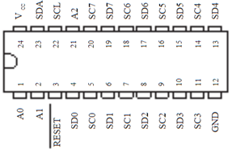
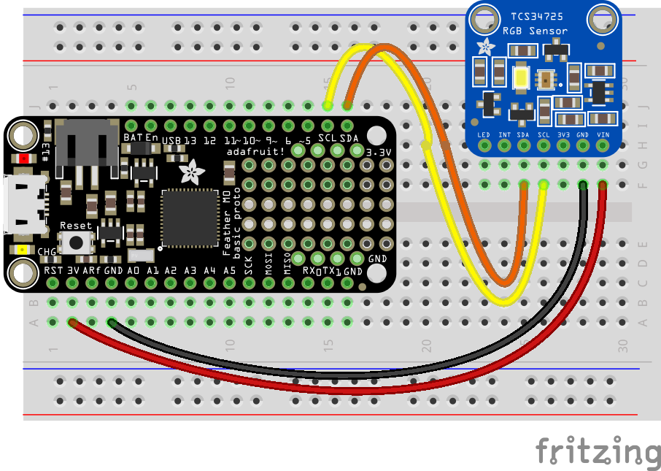
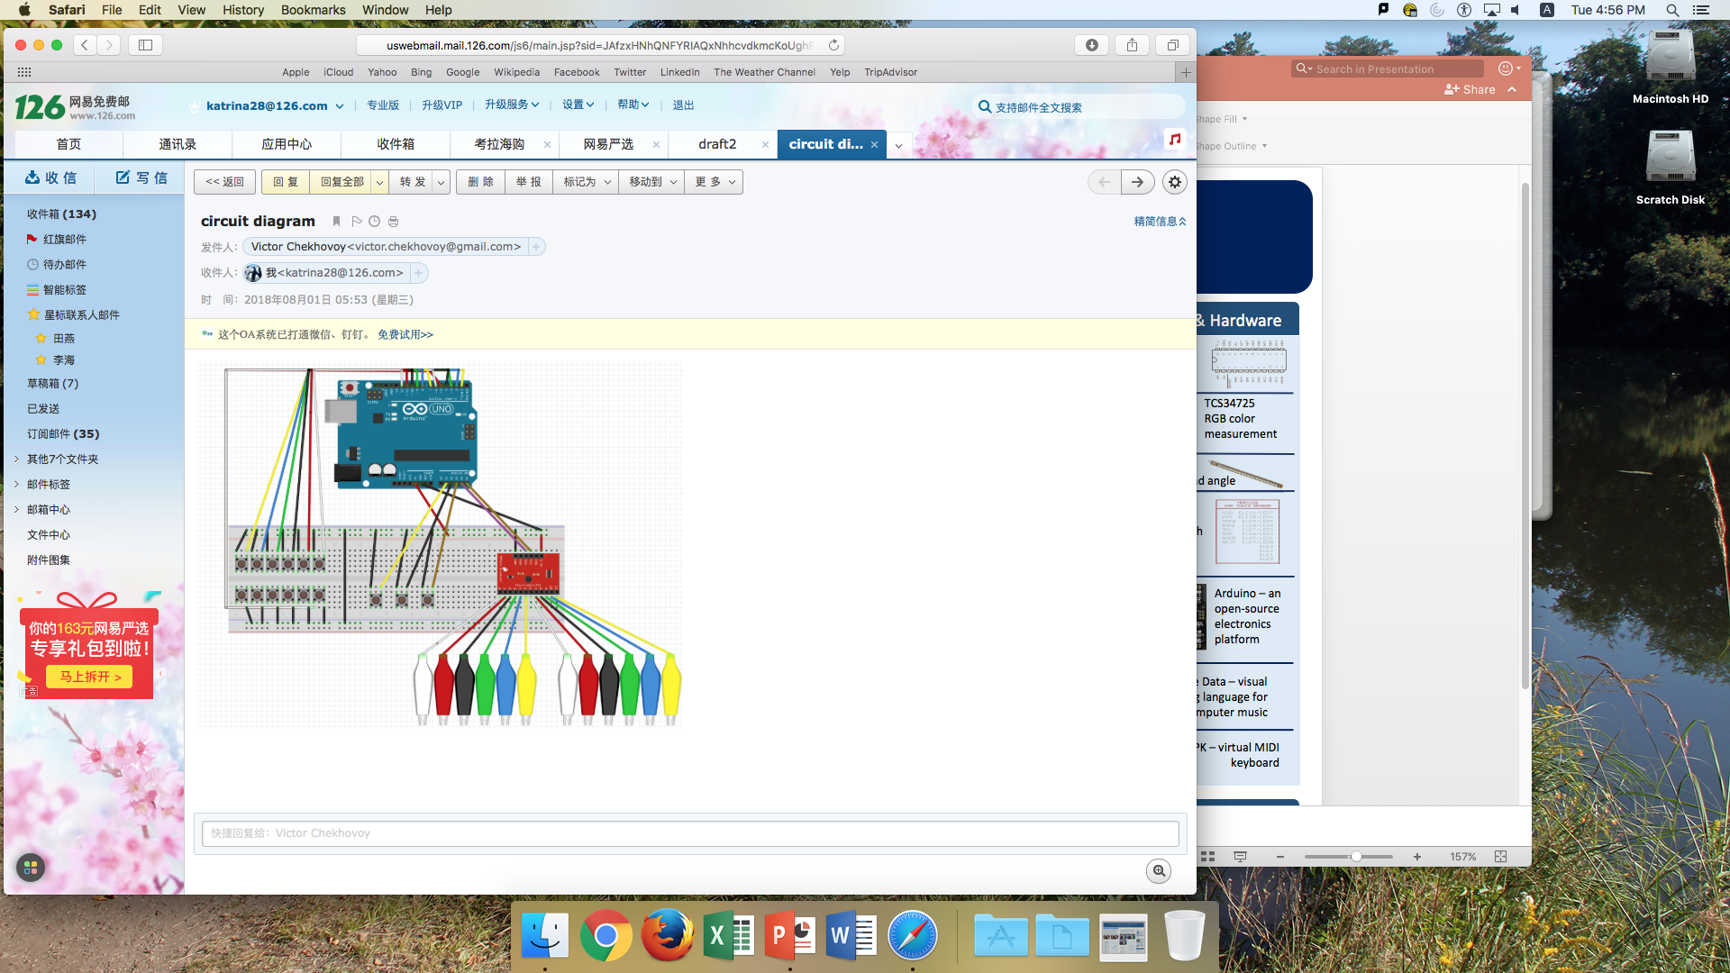
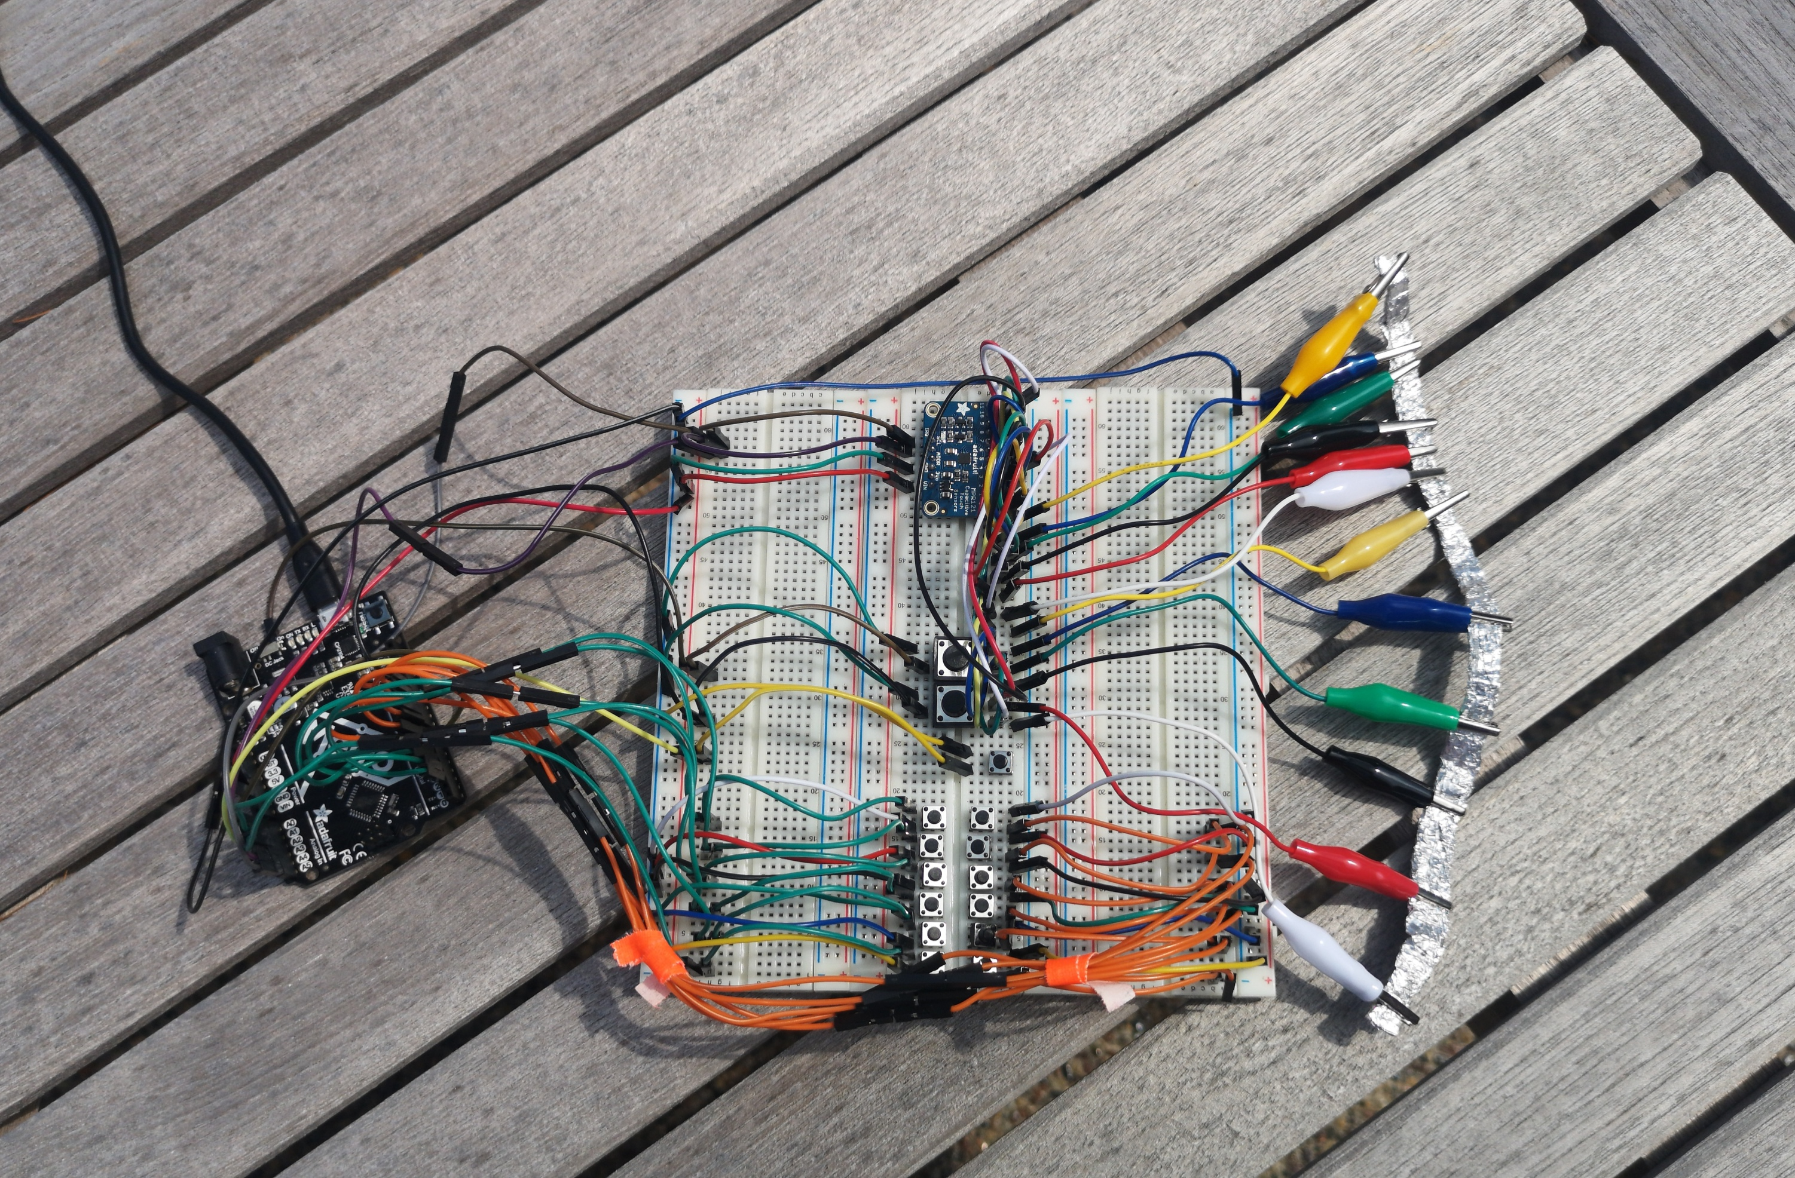
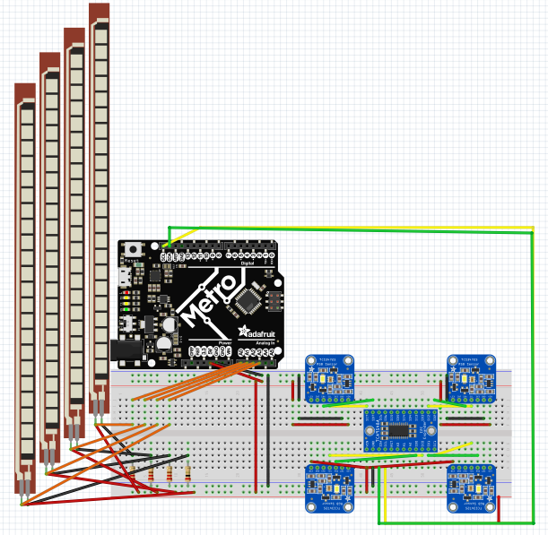
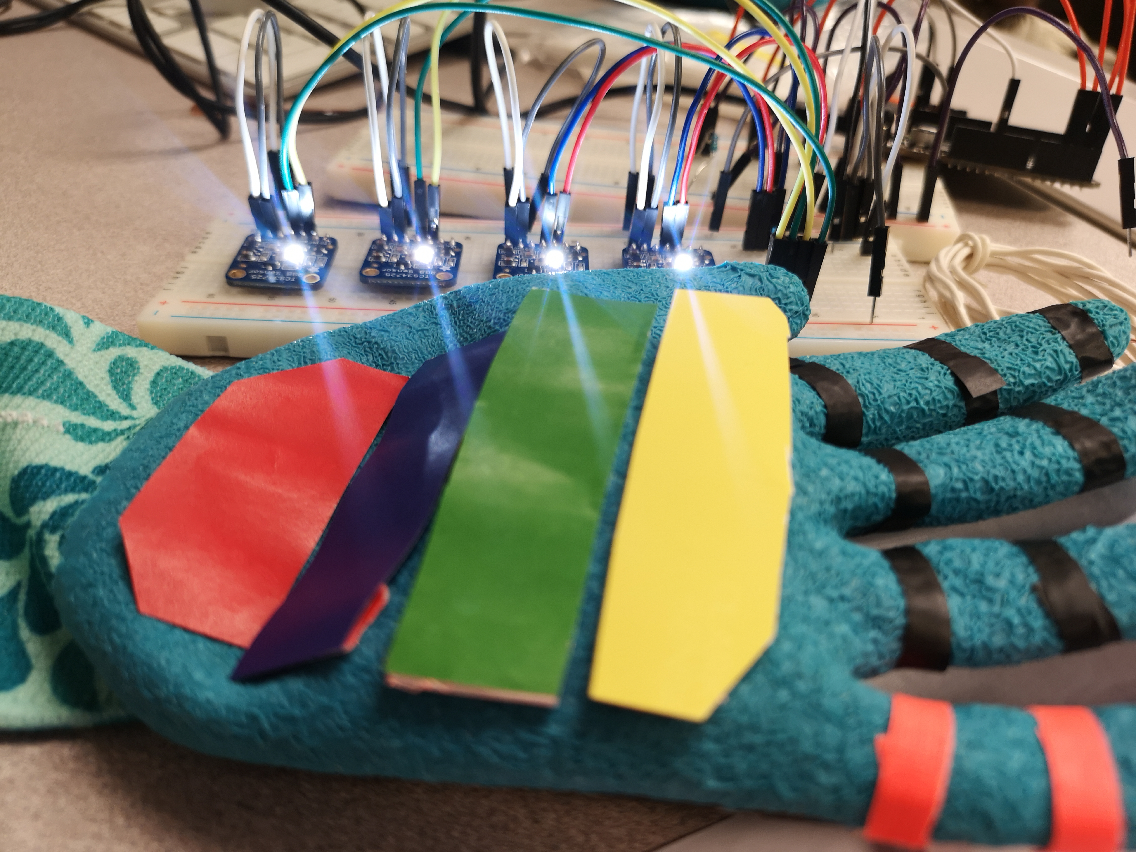
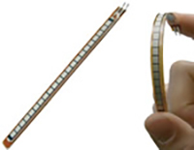
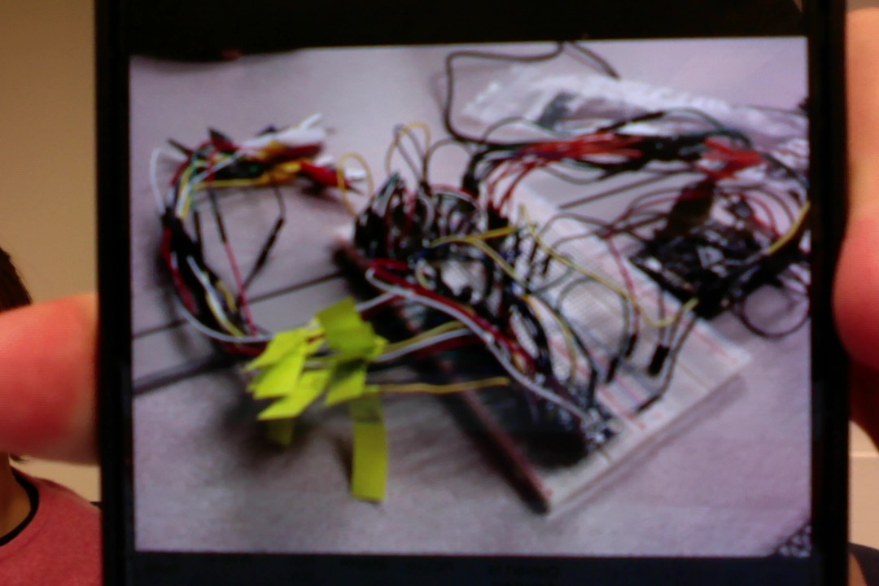
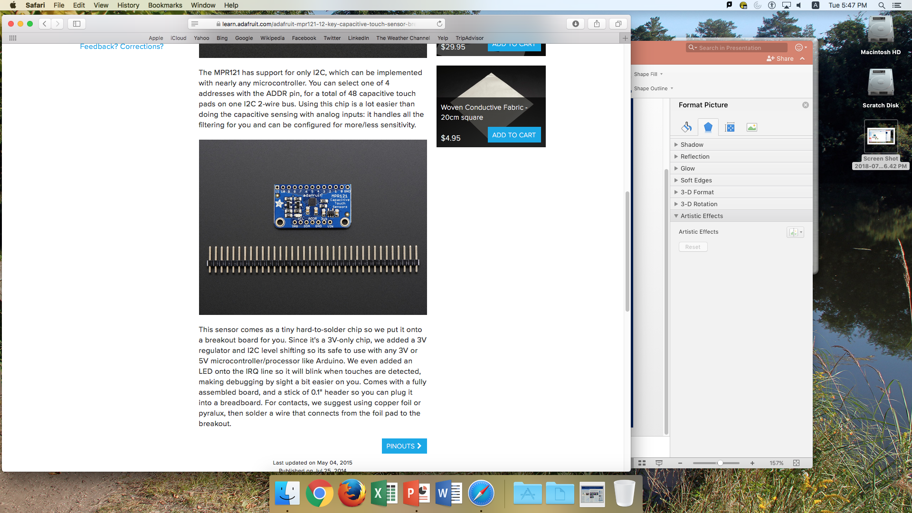
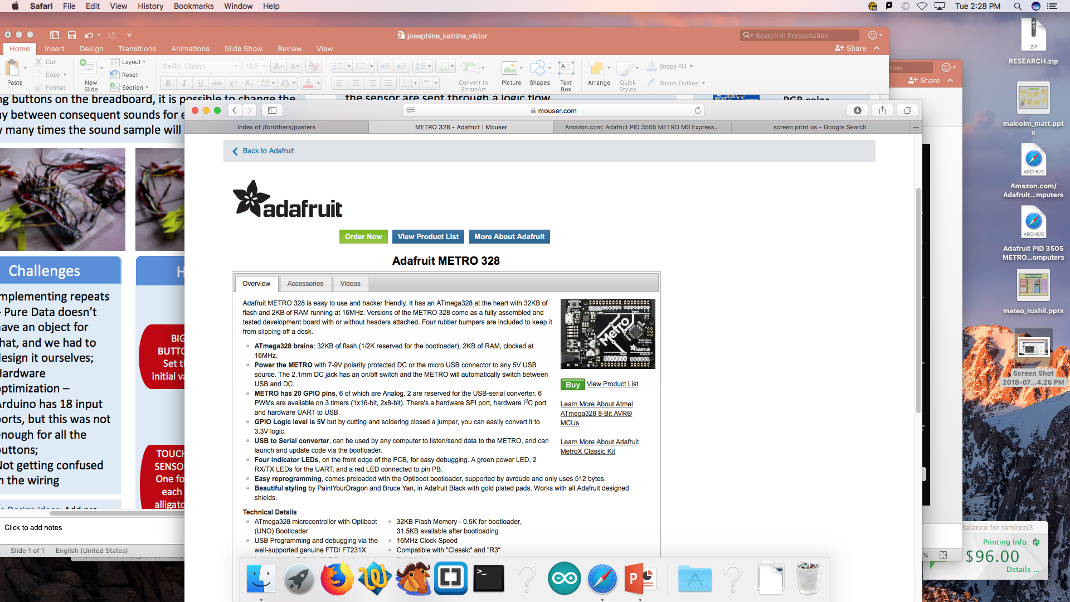
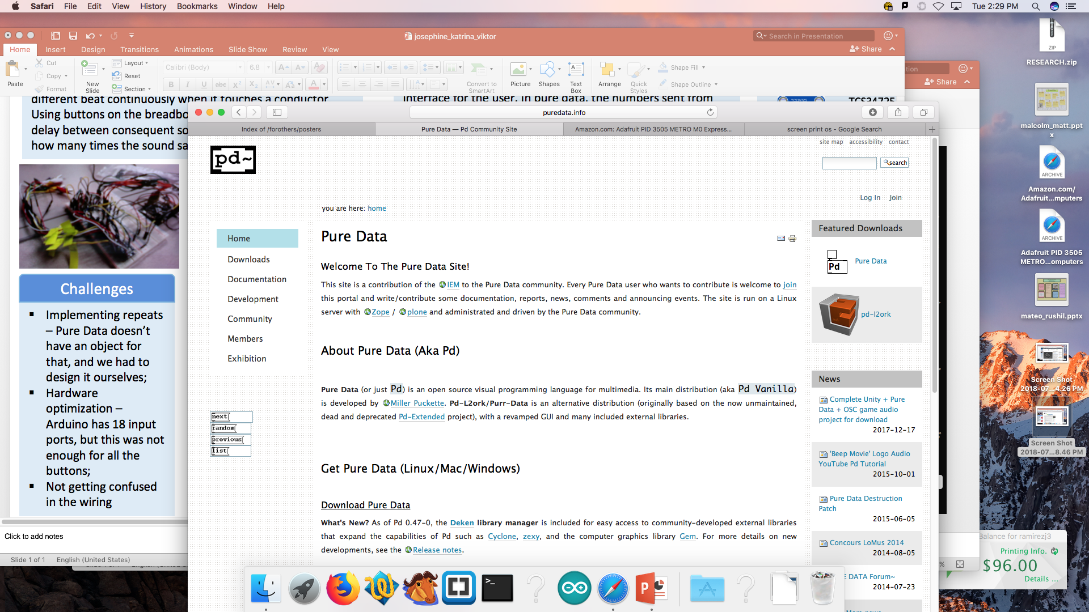
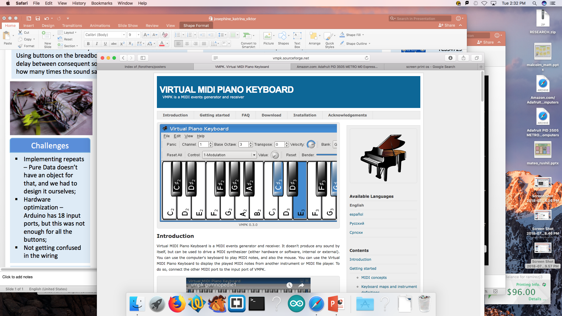
Designing a Digital, Interactive Music Experience
Katrina Li, Viktor Chekhovoi, Josephine Ramirez
Digital Violin
Digital Violin
Software & Hardware
The goal of this project is to create an instrument that would allow its users to create unique rhythms. It has 12 clips; each of them plays a beat when it touches a conductor. Buttons are used to change the delay between sounds, as well as how many times the sound will play in a row.
Designed to simulate a violin, the digital violin uses both flex and color sensors to optimize violin like positions and sounds. A glove is used to mount the sensors, and create a wearable interface for the user. In pure data, the numbers sent from the sensor are sent through a logic flow.
TCA9548A
multiplexer
TCS34725
RGB color measurement
Flex sensor
Measures bend angle
Adafruit MPR121 touch sensor
Challenges
How it Works
How it Works
Arduino – an open-source electronics platform
Implementing repeats – Pure Data doesn’t have an object for that, and we had to design it ourselves;
Hardware optimization – to arrange sufficient button ports for 18 buttons
Not getting confused in the wiring
SMALL BUTTONS
Change the delay/number of repeats
Challenges
1 Send the color sensor value for string name (R,G,B,Y = G,D,A,E)
Mounting hardware to the user interface
Controlling 4 color sensors
Calibrating the color sensors
Calibrating the flex sensors
Color coding
2 Which color sensor is being used
BIG BUTTONS
Set the initial values
Pure Data – visual programming language
for creating computer music
VMPK – virtual MIDI keyboard
Arduino
Arduino
TOUCH SENSOR
One for each alligator clip
3 Flex Sensor angle = 0 or 1 for on or off
References
Future Design Ideas: Include the possibility to shift for a more realistic experience; arrange a more comfortable experience for violin players.
Professor: Chris Johnson
Website: https://twodee.org/blog/
Research Assistant: Sam “Bob” Wiseman
Hardware tutorials: https://www.adafruit.com
Software tips: https://forum.arduino.cc
Inspiration: https://www.instructables.com/id/ANDI-Random-Rhythm-Generator-Electronics/
Future Design Ideas: Add pre-made background music;
Improve user interface, make the controls more intuitive.
Pure Data
Pure Data

